Slide 1
Advanced Machine Learning Techniques for Accurate Autism Spectrum Disorder Classification
Rupa Samodder

Slide 2
Introduction
▶ Autism Spectrum Disorder (ASD) affects approximately 1% of global population
▶ Early and accurate detection is crucial for timely intervention
▶ Machine learning offers promising diagnostic tools

Slide 3
Literature Review
▶ Models such as Random Forests, Decision Trees, and Naïve Bayes are widely employed.
▶ Ensemble methods and deep learning models (e.g., CNNs) have achieved accuracies exceeding 95%, depending on the dataset size and feature quality.
▶ Challenges remain in interpretability and computational efficiency.

Slide 4
Objectives
▶ Leverage multiple machine learning algorithms
▶ Classify ASD status in a dataset of 703 individuals
▶ Evaluate performance of clustering and supervised learning models
▶ Identify critical predictors of ASD

Slide 5
Methodology
1. Data Collection and Preprocessing
2. Algorithm Selection
▶ K-Nearest Neighbors
▶ Support Vector Machines
▶ Random Forest
▶ Ensemble Methods
3. Cross-Validation and Hyperparameter Tuning
4. Performance Evaluation

Slide 6
Clustering Analysis
▶ 3 Clusters with Silhouette Score: 0.1199
▶ Low cluster separability indicates data complexity
▶ Observations:
▶ ASD-positive samples clustered distinctly
▶ Non-ASD samples distributed across clusters

Slide 7
Supervised Learning Performance
▶ Random Forest Classifier
▶ Achieved Perfect Accuracy: 1.0
▶ Precision, Recall, F1-Score: 1.00 for both classes
▶ Ensemble Model
▶ Consistent Perfect Performance
▶ No Misclassifications

Slide 8
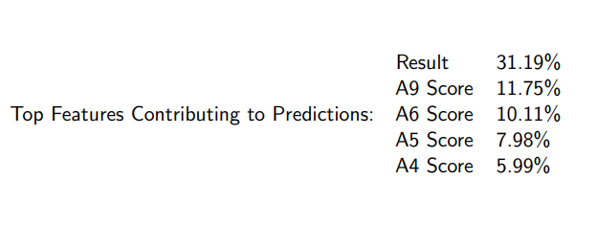
Feature Importance

Slide 9
Key Findings
▶ Supervised learning outperforms unsupervised clustering
▶ Autism screening scores are critical predictors
▶ Ensemble learning demonstrates high classification performance
▶ Perfect accuracy suggests robust feature selection

Slide 10
Future Work
▶ Advanced feature engineering
▶ Deep learning approaches
▶ Improve unsupervised clustering methods
▶ Enhance model generalizability

Slide 11
Conclusion
▶ Machine learning shows significant potential in ASD diagnosis
▶ Combination of feature importance and optimized classification techniques
▶ Promising approach for binary classification tasks

